Slide 1

Customer Story
IPng Networks AS8298
Pim van Pelt <pim@ipng.ch> • 2022-06-10 • Baur au Lac, Zurich
Notes:
Thanks for the invite: Frederic Gargula
Thanks for the review: Anastasia Yarmysh
Pim van Pelt is known for SixXS, a global IPv6 tunnelbroker which ran from 2001-2017. In this journey, he found that kernel routing at scale (many interfaces, many prefixes or many packets/sec) were better handled in userspace than server kernels (either FreeBSD or Linux). Today, Pim operates IPng Networks GmbH, a small internet provider in Zurich, Switzerland. IPng Networks is using software-based off-the-shelf PC routers which will give silicon-based routers a run for their money. In this talk, we will explore Intel's DataPlane Development Kit (https://dpdk.org), open source dataplane solutions such as VPP (https://fd.io), DANOS (https://danosproject.org), DPDK based loadtesting (https://trex-tgn.cisco.com) and discuss performance benchmarking results from the field.

Slide 2

Introduction
Pim van Pelt (PBVP1-RIPE)
Member of the RIPE community since 1999 (RIPE #34)
  Has used pim@ipng.nl for 22 years
  And also pim@ipng.ch for 15 years
  Incorporated ipng.ch in Switzerland in 2021

Slide 3
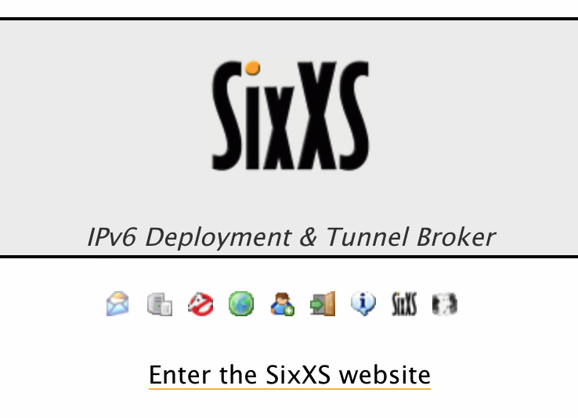
Introduction
SixXS - a global IPv6 Tunnelbroker
Member of the RIPE community since 1999 (RIPE #34)
Founded SixXS w/ Jeroen Massar [ref]
Operated SixXS from ca. 1999 - 2017 [sunset]
Used AS8298 for Ghost Route Hunter (2003) [RIPE #44]

Slide 4
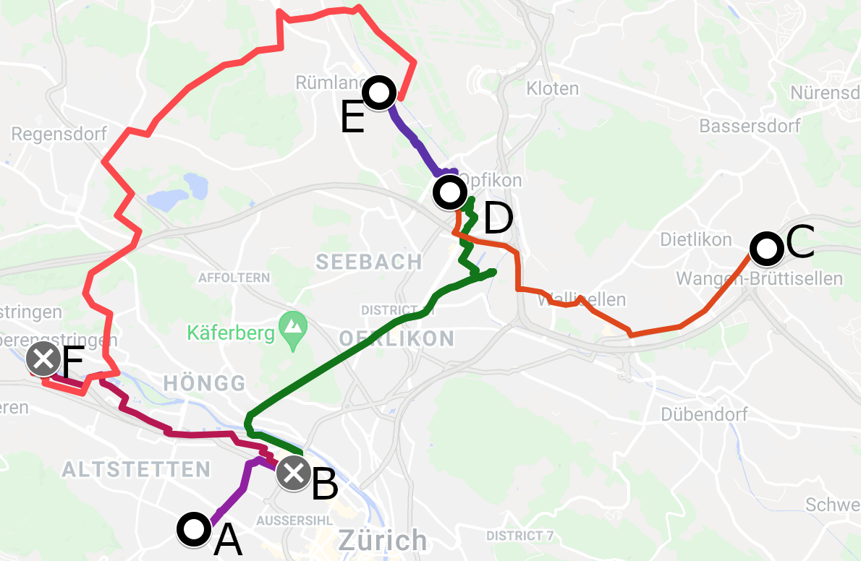
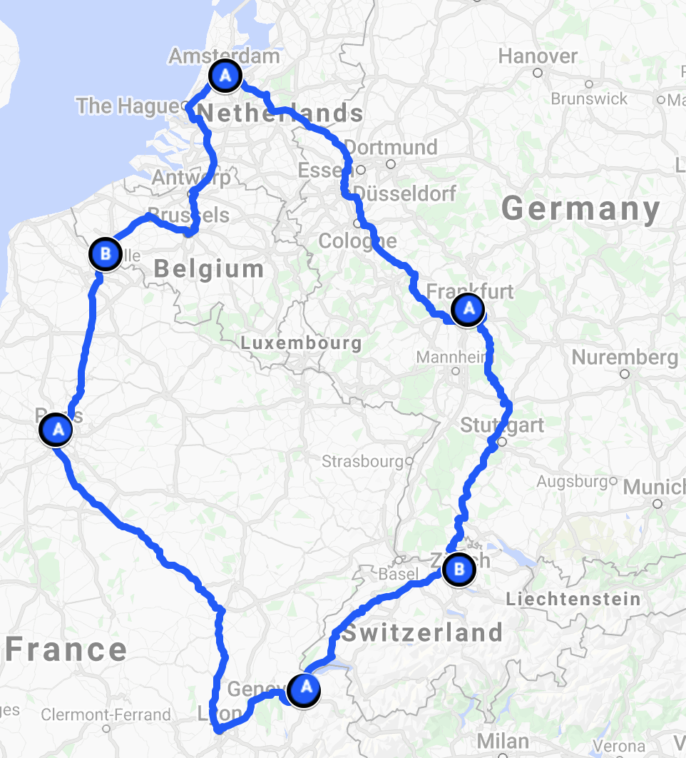
Introduction
IPng Networks GmbH
Developer of Software Routers - VPP and DPDK [ref]
Tiny operator from Brüttisellen (ZH), Switzerland [ref]
Twelve VPP/Bird2 routers [ref] (UN/LOCODE names)
European ring: peering on the FLAP* [ref] ~1850 adjacencies
Acquired AS8298 from SixXS [ref]
•
Notes:
I recently renumbered my ISP from AS50869 into AS8298 (of which an exciting step happens today/tomorrow, maybe we can do it live in Berne together!), all while being carried by a European backbone operating VPP and Bird2 but that’s a different story (and a different presentation, please check out my previous talk at RIPE #83).
Back to this presentation: I happen to think that the CPUs of today are as powerful or better than the ASICs and FPGAs of a decade ago, if used correctly.
I’ve worked a fair bit with DPDK and VPP to enable my little basement ISP to gain 100Mpps of forwarding capacity at a fraction of the cost of commercial silicon based vendors. This talk is an in-depth review of the work I’ve done to enable VPP to be driven by any Netlink capable controlplane (Bird, FRR, OpenBGP, et cetera).
VPP Linux CP - Part1 (2021-08-12)
VPP Linux CP - Part2 (2021-08-13)
VPP Linux CP - Part3 (2021-08-15)
VPP Linux CP - Part4 (2021-08-25)
VPP Linux CP - Part5 (2021-09-02)
VPP Linux CP - Part6 (2021-09-11)
VPP Linux CP - Part7 (2021-09-21)
*) OK the FLAP stands for Frankfurt, Lille, Amsterdam and Paris in my case - deployment articles below:
IPng arrives in Frankfurt (2021-05-17)
IPng arrives in Amsterdam (2021-05-25)
IPng arrives in Lille (2021-05-28)
IPng arrives in Paris (2021-06-01)
IPng arrives in Geneva (2021-07-03)

Slide 5

Vector Packet Processing
VPP reads a vector of up to 256 packets from its interfaces:
Packets are prefetched (or directly written) into CPU d-cache
All packets go through a directed graph
  First packet: graph node’s code loaded into CPU i-cache
  All additional packets: fully in d/i-cache: 7-20x faster
Packets then traverse as a vector into the next node(s)
  Optimized with SIMD (SSE, AVX, AVX512, …)
  No context switches, good TLB hit rate due to hugepages
  Lockless: multi-threading gives linear scaling
Hardware offload: use silicon if available
Plugins: rearrange the graph nodes and add functionality
virtio-input
dpdk-input
ethernet-
input
ip6-input
ip4-input
mpls-input
...
...
ip4-lookup
ip4-rewrite-transit
ip4-local
ethernet-
output
interface-
output
Notes:
VPP is all about processing packets wicked fast, and it uses underlying DPDK and silicon offloading where available:
In the previous slide we learned that it takes ~70ns to access main memory – not much time to do work if the CPU is sitting around, waiting for memory access.
At 10Gbit Ethernet, 64 byte packets can arrive at a maximum rate of 14.88Mpps – that’s 67nsec per packet.
With 2GHz CPU core each clock cycle is 0.5nsec – that’s 134 clock cycles per packet.
The best way to speed things up, is to limit use of main memory, and instead read our packets and necessary data/code into the CPU’s data cache. A few tricks we can use:
We can pre-fetch our (small) code routines that do specific things (like dpdk-input, ethernet-input, ip4-input or ip4-lookup or ethernet-output) into the CPU’s instruction cache; the first packet will incur this overhead to read this stuff into the CPU’s cache, but the second and further packets will not need memory at all.
Node dispatch functions typically comprise <250 lines of code
First choice: the function fits in the L1 I-cache
Second choice: multiple foreach_vector_element passes, improving branch prediction
Third choice: use multiple nodes
In modern CPUs, we can use so-called Data Direct IO [ref], which allows the PCIe device to inject its data directly into the data cache.
Some vector CPU instructions like Streaming Single Instruction Multiple Data Extensions (SSE) [ref] or Advanced Vector Extensions (AVX, also known as Sandy Bridge New Extensions) [ref] are a perfect match; they can apply the same operation on any number of packets simultaneously
Sunstantial wins can be obtained by offloading things to the NIC, if possible. Most modern NICs support lots of optimizations (VLAN and Qin* tagging/stripping, IPv4 checksum, UDP/TCP checksum, TCP segmentation, VXLAN/GENEVE encapsulation) can all be done in hardware; so VPP doesn’t bother doing them!
Other offloads, particularly crypto acceleration are very common: Advanced Encryption Standard / New Instructions [ref], Intel’s QuickAssist Technology [ref].
It’s things like these that can greatly improve forwarding efficiency and throughput. VPP allows graph nodes to be added, removed, re-implemented, and graph ordering changed at runtime. It’s easy to insert a graph node to do basically anything you’d like with the inbound or outbound packets.

Slide 6
Vector Packet Processing - example
pim@hippo:~$ vppctl
vpp# set interface state TenGigabitEthernet3/0/0 up
vpp# set interface mtu packet 9000 TenGigabitEthernet3/0/0
vpp# set interface ip address TenGigabitEthernet3/0/0 2001:db8:0:1::2/64
vpp# set interface ip address TenGigabitEthernet3/0/0 192.0.2.2/24
vpp# ip route add 2000::/3 via 2001:db8:0:1::1
vpp# ip route add 0.0.0.0/0 via 192.0.2.1
pim@hippo:~$ vppctl show interface TenGigabitEthernet3/0/0
TenGigabitEthernet3/0/0 up 9000/0/0/0 rx packets 5969930253
rx bytes 2139798549228
tx packets 14517083897
tx bytes 6864831067486
drops 945
ip4 3862409855
ip6 2107502378
Always hungry
for packets …
virtio-input
dpdk-input
ethernet-
input
ip6-input
ip4-input
mpls-input
...
...
ip4-lookup
ip4-rewrite-transit
ip4-local
ethernet-
output
interface-
output
•
Notes:
VPP ships with an API and a CLI vppctl which allows for lots of interactive configuration. It can also read CLI-style commands at startup, so a crash/reboot yields a running VPP again.
Lots and lots of cool features in VPP are provided as plugins. For example, L2TP, GTPU, NAT4, NAT6, CNAT, LACP, DHCP v4/v6 client, IKE v2, PPPoE, SRV6, Wireguard, VRRP, and the list goes on and on:
pim@hippo:~/src/vpp/src/plugins$ ls
abf bufmon crypto_native dns http_static l3xc lldp mss_clamp ping srv6-ad svs urpf
acl builtinurl crypto_openssl dpdk igmp lacp mactime nat pppoe srv6-ad-flow tlsmbedtls vmxnet3
adl cdp crypto_sw_scheduler flowprobe ikev2 lb map nsh quic srv6-am tlsopenssl vrrp
af_xdp CMakeLists.txt ct6 geneve ila marvell nsim rdma stn srv6-as tlspicotls wireguard
arping cnat dhcp gtpu ioam mdata oddbuf snort srtp srv6-mobile tracedump
avf crypto_ipsecmb dispatch-trace hs_apps l2tp lisp memif perfmon
Most plugins can be configured by the CLI and programmatically via the API. But notably missing in this long list is anything to do with routing protocols -- no OSPF, ISIS, BGP, LDP, BFD. Such a shame! And what about managing a machine that is running VPP? Should there be an extra networkcard for out-of-band management? That’s not very useful …
Let’s take a look at the next slide for what happens next!

Slide 7
VPP: Linux Controlplane
Wrote a VPP Plugin [github] that:
Creates tun/tap interface in Linux for a given VPP interface
  VPP->Linux: Traffic to ip4-local and ip6-local is punted into TAP
  Linux->VPP: packets into TAP are inserted into virtio-input
Syncs interface changes in VPP into Linux
Listens to Netlink messages and syncs Linux changes into VPP
Allows operators to use VPP almost exactly as if it were Linux
Configure interfaces, addresses, routes by hand, or ...
...using common tools like ip(1), FRR, or BIRD/BIRD2
⇒ VPP is Linux’s software equivalent of an ASIC dataplane ⇐
virtio-input
dpdk-input
ethernet-
input
ip6-input
ip4-input
mpls-input
...
...
ip4-lookup
ip4-rewrite-transit
ip4-local
ethernet-
output
interface-
output
Notes:
This plugin allows VPP to integrate with the Linux kernel. The general model is that Linux is the network stack, i.e. it has the control plane protocols, like ARP, IPv6 ND/MLD, ping, etc, and VPP provides a SW based ASIC for forwarding.
Interfaces: VPP owns the interfaces in the system; physical (.e.g PCI), quasi physical (e.g. vhost), or virtual (e.g. tunnel). However, for the Linux networking stack to function it needs a representation of these interfaces; it needs a mirror image in the kernel. For this mirror we use a TAP interface, if the VPP interface is multi-point, a TUN if it's point-to-point. A physical and its mirror form an interface 'pair', also referred to as a Linux Interface Pair or LIP. The host interface has two identities; the sw_if_index of the TAP and the virtual interface index in the kernel. It may be in a Linux network namespace. The creation of the interface pairs is required from the control plane. It can be statically configured in the VPP startup configuration file. The intent here is to make the pair creation explicit, rather than have VPP guess which of the interfaces it owns require a mirror.
Configuration: Linux will send and receive packets on the mirrored tap/tun interfaces. Any configuration that is made on these Linux interfaces, also needs to be applied on the corresponding physical interface in VPP. And if VPP makes the changes, those need to be applied on the corresponding Linux tap/tun device. Linux will own the [ARP/ND] neighbor tables (which will be copied via netlink to VPP also). This means that Linux will send packets with the peer's MAC address in the rewrite to VPP. The receiving TAP interface must therefore be in promiscuous mode.
Forwarding: The basic principle is to x-connect traffic from a Linux host interface (received on the tap/tun) to its paired the physical, and vice-versa.
Host to Physical - All packets sent by the host, and received by VPP on a tap/tun should be sent to its paired physical interface. However, they should be sent with the same consequences as if they had originated from VPP, i.e. they should be subject to all output features on the physical interface. To achieve this there is a per-IP-address-family (AF) node inserted in the per-AF input feature arc. The node must be per-AF, since it must be a sibling of a start node for the ipX-output feature arc. This node uses the packet's L2 rewrite to search for the adjacency that VPP would have used to send this packet; this adjacency is stored in the buffer's meta data so that it is available to all output features. Then the packet is sent through the physical interface's IP output feature arc. All ARP packets are x-connected from the tap to the physical.
Physical to Host - All ARP packets received on the physical are sent to the paired tap. This allows the Linux network stack to build the neighbor table. IP packets that are punted are sent to the host. They are sent on the tap that is paired with the physical on which they were originally received. The packet is sent on the tap/tun 'exactly' as it was received (i.e. with the L2 rewrite) but post any translations that input features may have made.
For the curious …
Part1 - Create sub-interface (.1q, .1ad, q-in-q, q-in-ad) in Linux
Part2 - Sync link state, MTU and IP addresses in Linux
Part3 - Automatically create sub-interfaces in Linux
Part4 - Netlink: Sync link state, MTU, neighbor, IP addresses,
create new sub-interface (.1q, .1ad, q-in-*) in VPP
Part5 - Netlink: Sync routes in VPP
Part6 - Expose interface stats from VPP in SNMP
Part7 - HOWTO: Installation and Configuration in Production
*) Thanks to Neale Ranns, Matt Smith and Jon Loeliger for the collaboration

Slide 8
VPP: Linux Controlplane - ip
pim@hippo:~$ vppctl lcp create TenGigabitEthernet3/0/0 host-if xe0
pim@hippo:~$ sudo ip link set xe0 up mtu 9000
pim@hippo:~$ sudo ip address add 2001:db8:0:1::2/64 dev xe0
pim@hippo:~$ sudo ip address add 192.0.2.2/24 dev xe0
virtio-input
dpdk-input
ethernet-
input
pim@hippo:~$ sudo ip link add link xe0 name servers type vlan id 101
pim@hippo:~$ sudo ip link set servers mtu 1500 up
pim@hippo:~$ sudo ip addr add 2001:678:d78:3::86/64 dev servers
pim@hippo:~$ sudo ip addr add 194.1.163.86/27 dev servers
pim@hippo:~$ sudo ip route add default via 2001:678:d78:3::1
pim@hippo:~$ sudo ip route add default via 194.1.163.65
ip6-input
ip4-input
mpls-input
...
...
ip4-lookup
ip4-rewrite-transit
ip4-local
pim@hippo:~$ ping 8.8.8.8
PING 8.8.8.8 (8.8.8.8): 56 data bytes
64 bytes from 8.8.8.8: icmp_seq=0 ttl=121 time=1.348 ms
...
ethernet-
output
interface-
output
•
Notes:
Notice that with this plugin enabled, the only thing I have to do is create the Linux Interface Pair with lcp create. From there on, an interface appears back in Linux with the given name, xe0 in this case, and it can be manipulated just as any regular interface code. VLANs can be created, IP addresses added/removed, routes placed, etc. For most intents and purposes, the VPP tap interface looks and feels like a normal interface!
One thing worth mentioning, is that tcpdump’ing on such an interface will show only packets that are destined for the host itself, not the packets that the dataplane is forwarding. This is because the input feature arc will only punt packets destined for local into the TAP. But, seeing as normal IPv4 and IPv6 (and ARP/ND) traffic is punted, pinging an IP address or telnet’ing to it would end up through VPP and into the tap, and then into the kernel again. Packets would show up! So we can easily listen on TCP ports, consume and emit multicast, and all of those things.
For example, we can listen an SSH daemon on port 22, or a BGPd on port 179. Wait, BGP?

Slide 9

VPP: Linux Controlplane - Bird2
pim@defra0:~$ birdc show route count
BIRD 2.0.7 ready.
8018726 of 8018726 routes for 907513 networks in table master4
1467252 of 1467252 routes for 144687 networks in table master6
523590 of 523590 routes for 261795 networks in table t_roa4
105464 of 105464 routes for 52732 networks in table t_roa6
Total: 10115032 of 10115032 routes for 1366727 networks in 4 tables
pim@defra0:~$ birdc show ospf neighbor ospf6
BIRD 2.0.7 ready.
ospf6:
Router ID Pri State DTime Interface Router IP
194.1.163.7 1 Full/PtP 30.715 xe1-3.100 fe80::6a05:caff:fe32:3e49
194.1.163.34 1 Full/PtP 35.056 xe1-2.200 fe80::6a05:caff:fe32:45ae
194.1.163.140 1 Full/DR 37.944 xe1-1.2006 fe80::5054:ff:feb0:442c
Converges full BGP table in 7s
virtio-input
dpdk-input
ethernet-
input
ip6-input
ip4-input
mpls-input
...
...
ip4-lookup
ip4-rewrite-transit
ip4-local
ethernet-
output
interface-
output
•
Notes:
Seeing as we now have full local IPv4 and IPv6 punted into the TAP, and multicast/unicast are both supported, a full suite of routing protocols becomes available. I’ve invested in Bird2 at IPng Networks, but equally well any other common software, like Zebra/Quagga/FRR can be used; or basically anything that would work on a Linux machine. As long as it manipulates the interface state with Netlink (which literally everything would do); it will work with VPP’s Linux Controlplane plugins.
I guess you might be wondering: why do all of this effort just to re-create eth0 or eth1 back into Linux?? The answer: cuz it’s really really (really!) performant.

Slide 10

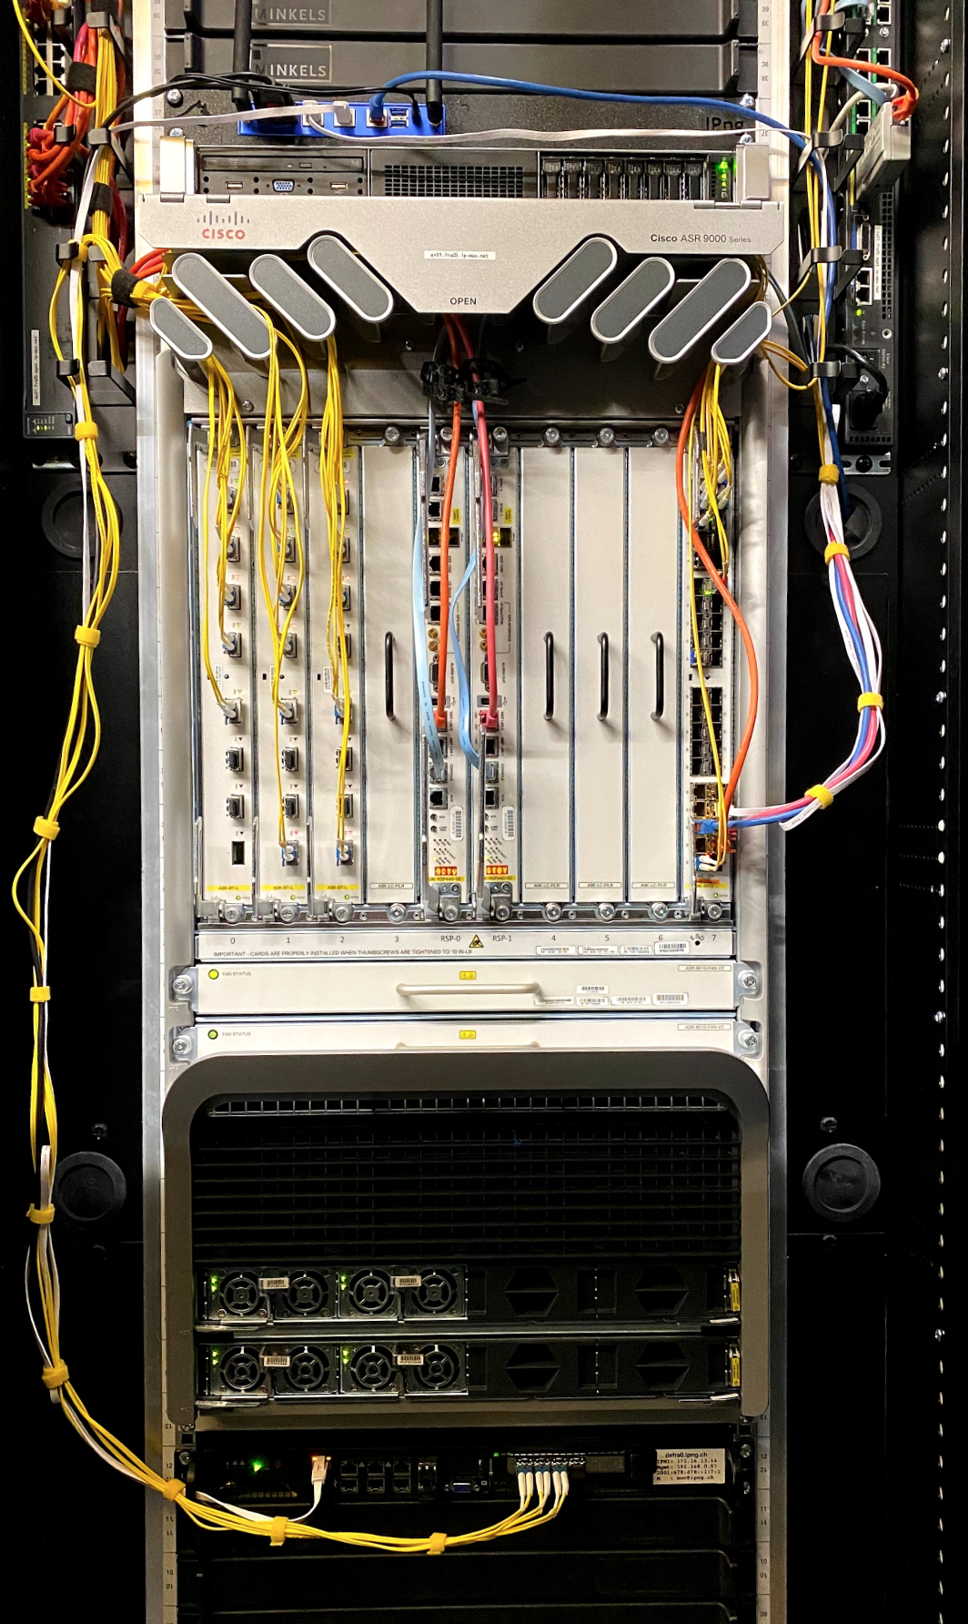
Deploying: Partnership with IP-Max
IP-Max:
30G DWDM Zurich-Frankfurt: three separate carriers/paths
10G DWDM Frankfurt-Amsterdam: NIKHEF
30G of LAG capacity towards DE-CIX
  Reseller of all DE-CIX exchange points
IPng Networks:
Te0/0/0/4 – EoMPLS to NTT/eShelter Rümlang (chrma0.ipng.ch)
Te0/1/0/4 – EoMPLS to Interxion Glattbrugg (chgtg0.ipng.ch)
Te0/2/0/4 – EoMPLS to NIKHEF Amsterdam (nlams0.ipng.ch)
DE-CIX Peering: 972 ASNs, 238K IPv4, 44K IPv6
DE-CIX Frankfurt (970 ASNs, peer with 810) ⇒ 156K IPv4 37K IPv6
DE-CIX Munich (176 ASNs present, peer with 154) ⇒ 62K IPv4 3K IPv6
DE-CIX Dusseldorf (208 ASNs present, peer with 183) ⇒ 19K IPv4 3K IPv6
DE-CIX Hamburg (170 ASNs present, peer with 152) ⇒ 1450 IPv4 215 IPv6
Notes:
pim@defra0:~$ ip ro | awk '{ print $5 }' | sort | uniq -c | sort -n
4 metric
7 kernel
1447 xe1-2.514
19006 xe1-2.516
62295 xe1-2.515
99881 xe1-0
124902 xe1-1
156214 xe1-2.503
449748 xe1-2.441
pim@defra0:~$ ip -6 ro | awk '{ print $5 }' | sort | uniq -c | sort -n
4 proto
18 kernel
215 xe1-2.514
2998 xe1-2.516
7189 xe1-2.515
11931 xe1-0
18715 xe1-1
36801 xe1-2.503
72282 xe1-2.441

Slide 11
IP-Max: Stable L2 backhaul to DE-CIX
pim@chrma0:~$ date
Thu Jun 9 23:08:50 CEST 2022
pim@chrma0:~$ birdc show bfd sessions
IP address Interface State Since Interval Timeout
194.1.163.9 xe0-0 Up 2022-04-20 12:35:57 0.100 3.000
fe80::3eec:efff:fe6a:8052 xe0-0 Up 2022-04-20 12:35:57 0.100 3.000
194.1.163.25 xe1-0.812 Up 2022-03-02 01:35:54 0.100 3.000
fe80::6a05:caff:fe32:3e48 xe1-0.812 Up 2022-03-02 01:35:54 0.100 3.000
194.1.163.16 xe1-0.400 Up 2022-04-21 02:36:44 0.100 3.000
fe80::3eec:efff:fe46:69b4 xe1-0.400 Up 2022-04-21 02:36:44 0.100 3.000
pim@chrma0:~$ ping defra0
PING defra0(defra0.ipng.ch (2001:678:d78::7)) 56 data bytes
…
--- defra0 ping statistics ---
5 packets transmitted, 5 received, 0% packet loss, time 4007ms
rtt min/avg/max/mdev = 5.702/5.744/5.786/0.026 ms
5.7ms FRA-ZRH
>3mo BFD up
virtio-input
dpdk-input
ethernet-
input
ip6-input
ip4-input
mpls-input
...
...
ip4-lookup
ip4-rewrite-transit
ip4-local
ethernet-
output
interface-
output
•

Slide 12

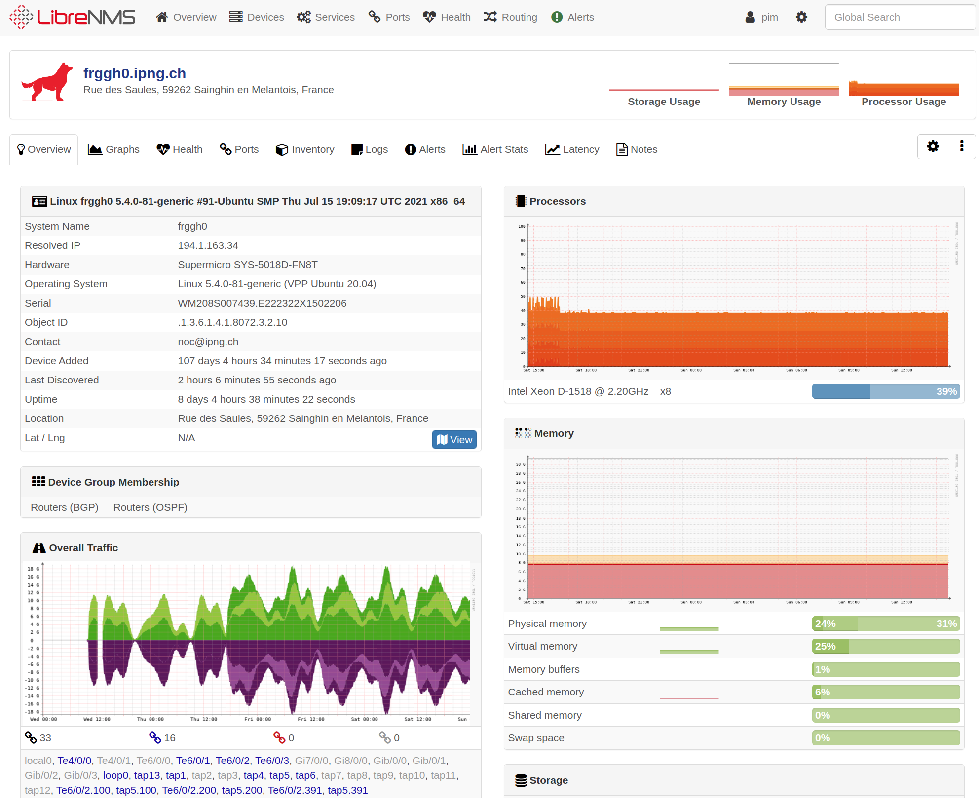
VPP: SNMP and NMS
Wrote an SNMP Agent [github]
Added logo to LibreNMS [ref]
Added distro to LibreNMS Agent [ref]
Is forwarding 18Gbps
•
Notes:
A few slides ago, I mentioned that only local traffic is punted into the Linux Interface Pair. This has a profound implication: any traffic seen on these devices, is only the traffic that is destined to the machine, not the traffic that is forwarded through the dataplane without being punted (ie. the majority of traffic).
VPP’s Stats Segment - VPP maintains lots of interesting statistics at runtime - for example for nodes and their activity, but also, importantly, for each interface known to the system. Alright! I find a Python library that allows for this data to be MMAPd and directly read as a dictionary, including some neat aggregation functions (see an example in src/vpp-api/python/vpp_papi/vpp_stats.py)
VPP’s API - In a previous project, I already got a little bit of exposure to the Python API (vpp_papi), and it’s pretty straight forward to use. Each API is published in a JSON file in /usr/share/vpp/api/{core,plugins}/ and those can be read by the Python library and exposed to callers. This gives me full programmatic read/write access to the VPP runtime configuration, which is super cool.
Introducing my SNMP AgentX for VPP:
Combining these two things together allows me to build an SNMP AgentX. It connects to VPP's statseg (statistics memory segment) by MMAPing it, so the user running the agent must have read access to /run/vpp/stats.sock. It also connects to VPP's API endpoint, so the user running the agent must have read/write access to /run/vpp/api.sock. Both of these are typically accomplished by running the agent as group vpp.
The agent connects to SNMP's agentx socket, which can be either a TCP socket (by default localhost:705), or a unix domain socket (by default /var/agentx/master) the latter being readable only by root. It's preferable to run as unprivileged user, so a TCP socket is preferred (and the default).
The agent incorporates a refactored/modified pyagentx. The upstream pyagentx code uses a threadpool and message queue, but it was not very stable. Often, due to lack of proper locking, updaters would overwrite parts of the MIB and as a result, any reads that were ongoing would abruptly be truncated. I refactored the code to be single-threaded, greatly simplifying the design (and eliminating the need for locking).

Slide 13
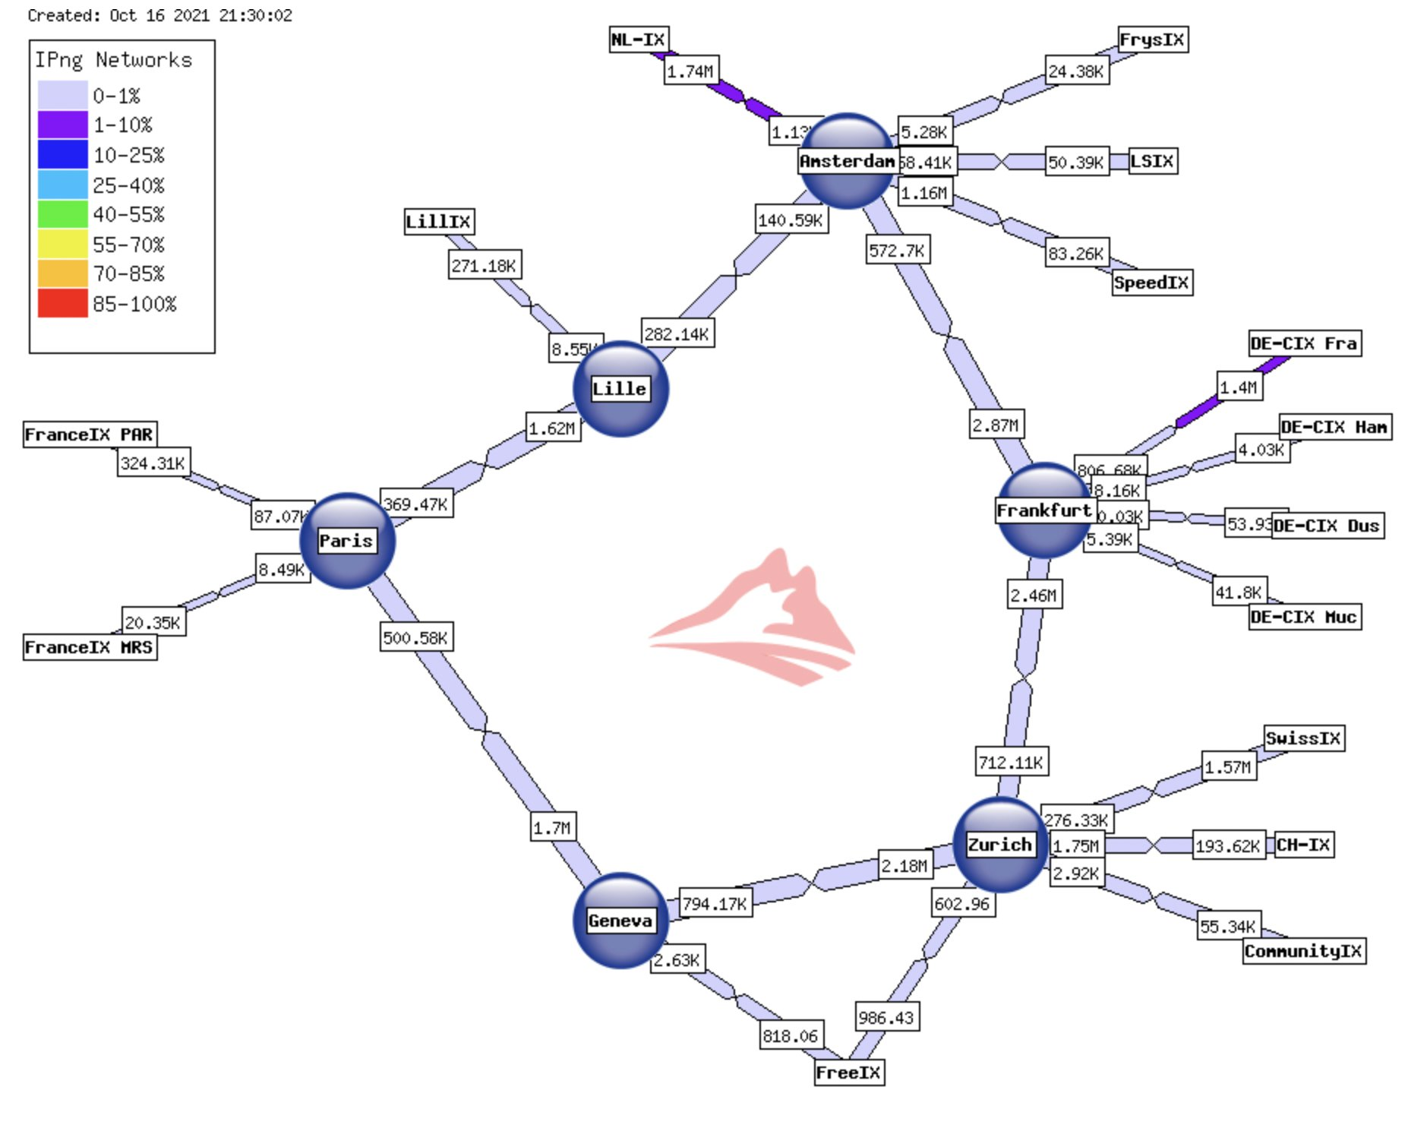

Questions, Discussion
If you peer with IPng Networks, thanks! If you don’t: please peer with AS8298 <peering@ipng.ch>
Useful Resources
VPP: fd.io
VPP Linux CP: Github
Articles: ipng.ch
Twitter: @IPngNetworks
Also: thanks for listening!

